Slide 1

Smart Canteen Ordering and Management System Using Spring Boot and React
SOA Project Review-1
Date& Time
 | Under the Guidance of Dr. Neelima Gogineni Professor, Department of Computer Science and Engineering, KLH CSE Bowrampet Campus
Team Members P.Rajendra – 2420030609 D.Mallikarjun – 2420030615 D.Praveen - 2420030370

Slide 2
Outline of Project Work
Focus
Introduction
Literature Survey
Challenges
Research Objectives
Conclusion & Future Work
References
Publications Details

Slide 3
Problem Statement
Traditional college canteens generally depend on manual ordering and communication between students and canteen staff. During peak hours, students have to stand in long queues, wait for food preparation, and communicate their orders manually. This process can result in increased waiting time, incorrect orders, difficulty in handling peak-hour demand, and problems in maintaining accurate order records.
The absence of a centralized digital system also makes it difficult for canteen staff to efficiently manage food availability, incoming orders, order preparation, and pickup verification. Therefore, there is a need for a secure and user-friendly digital platform that can connect students and canteen staff and manage the complete ordering and pickup process efficiently.

Slide 4
Objectives
To digitize the college canteen ordering process and reduce dependency on manual ordering.
To reduce student waiting and queue time by allowing students to browse the menu and place orders through a web application.
To provide an easy-to-use student interface for registration, login, menu browsing, cart management, and order placement.
To provide a centralized canteen management dashboard for authorized staff.
To enable real-time order status management through stages such as Placed, Confirmed, Preparing, Ready, and Completed.
To minimize incorrect or duplicate food collection through Order ID or QR-code-based pickup verification.
To maintain accurate digital records of users, food items, orders, order items, prices, and order statuses.
To provide food availability and low-stock tracking for better canteen management.
To generate sales reports and basic analytics that can help administrators understand demand and improve daily operations.
To implement secure role-based access using Spring Security and JWT as described in the proposed system

Slide 5
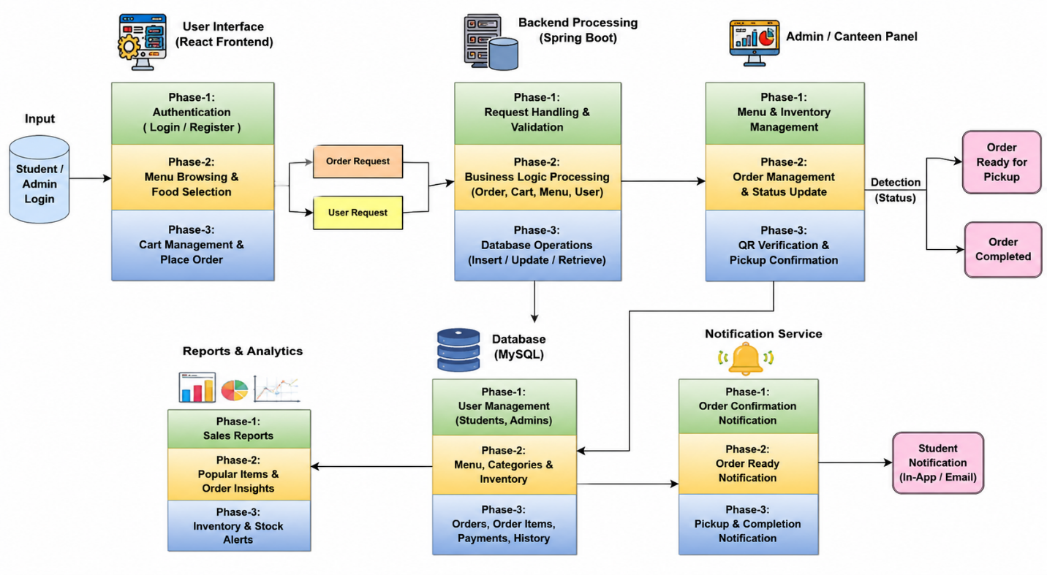
Project Architecture/Project Overview:

Slide 6
Literature Survey
Authors | Title of the Paper | Methodology | Inferences | Limitation/Future work
Rupali B. Kale et al. | Online Food Ordering System for College Canteen | Raspberry Pi, QR code scanner, LCD and Wi-Fi based ordering system | Automates manual canteen ordering and helps improve service efficiency. . | Hardware-based approach; scope for developing a more flexible web-based management system.
Pranav Bari et al. | Deploying an Intelligent Online Food Ordering System to Optimize College Canteen Operations | MERN stack with online ordering and machine-learning-based recommendations | Reduces waiting time and improves order management; personalized recommendations can improve user experience. | Focuses on MERN and ML; our work uses Spring Boot, React and MySQL with QR-based pickup verification.
Roshan Kolte et al. | Food Ordering for Campus | QR-enabled digital menu, online ordering and online payment | QR scanning provides quick menu access, ordering and token-based food pickup. | Mainly focuses on ordering and payment; further scope for complete order-status and administrative management.

Slide 7
Problem Gap Identification
The Problem Gap Identification is that traditional college canteens rely on manual ordering, which causes long queues, waiting time, incorrect orders, and difficulty in managing peak-hour demand. There is also no centralized system for managing food availability, order status, pickup, and records. The proposed system fills this gap by providing a single digital platform for online ordering, order tracking, food management, and QR/Order ID-based pickup verification.

Slide 8
Innovation, Creativity, and Novelty
The Innovation, Creativity, and Novelty of the project lies in combining online food ordering, digital menu management, real-time order tracking, notifications, and QR/Order ID-based pickup verification into a single platform. The system creatively connects students and canteen staff through a structured workflow from order placement to final pickup, reducing manual work and improving efficiency. Its novelty is the integration of React, Spring Boot, REST APIs, MySQL, and QR-based verification specifically for college canteen management.

Slide 9
Feasibility and Project Plan
TIMELINE CHART FOR EACH PHASE OF YOUR PROJECT SHOULD BE THERE AFTER EXPLANATION
Weeks 1–2: Understand the canteen problems and finalize requirements.
Weeks 2–3: Design the application architecture, modules, database, and API structure.
Weeks 3–4: Implement the MySQL database and required data structures.
Weeks 4–6: Develop the Spring Boot backend, REST APIs, authentication, and business logic.
Weeks 5–7: Develop the React student and admin interfaces.
Weeks 7–8: Integrate order processing, order-status workflow, notifications, and QR/Order ID pickup verification.
Weeks 8–9: Perform complete system integration and testing.
Weeks 9–10: Fix identified issues and optimize the application.
Weeks 10–11: Complete project documentation and prepare the demonstration.
Week 12: Final deployment, project demonstration, and presentation.

